Slide 1


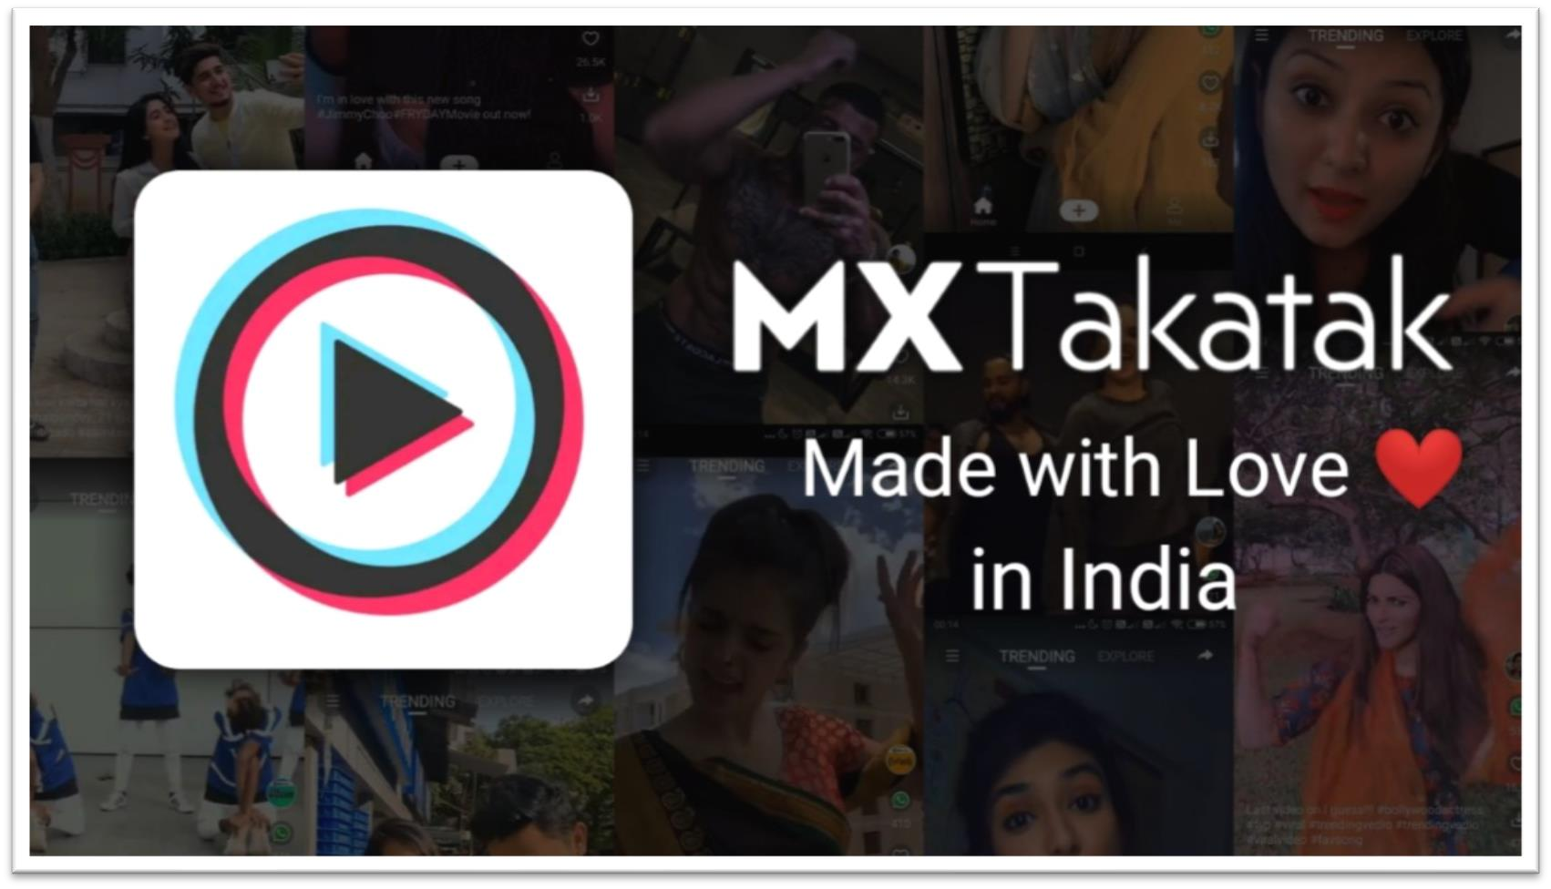
Subhadip Samanta
IIFT Delhi

Slide 2

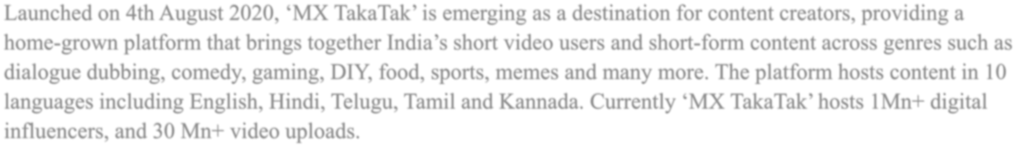
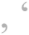







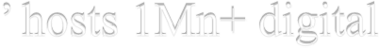
















MOJ

Slide 3


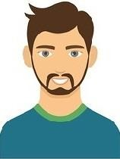


Alex, 19, Mumbai
Sneha, 28, Delhi
Piyush, 25, Indore
Famous graffiti artist in his collage. But has never put his work on any platform despite many times asked by his friend as he is camera conscious and is uncomfortable facing camera but is eager to show his work to the world.
Is a newbie tarot card reader and is looking for an online platform where she can start consulting her users and gain popularity. She finds short video apps as cringy and not comfortable in joining such apps to solve her purpose.
Works at a garment shop and loves dancing. In his free time, watches short video apps. After getting inspired by his favorite influencer he is thinking to start making his own content and
display his shop’s collection in the videos.
Users not comfortable facing cameras.
Users find short video apps cringy and hesitate joining the platform.
Users want a platform, where videos can also showcase their products.

Slide 4
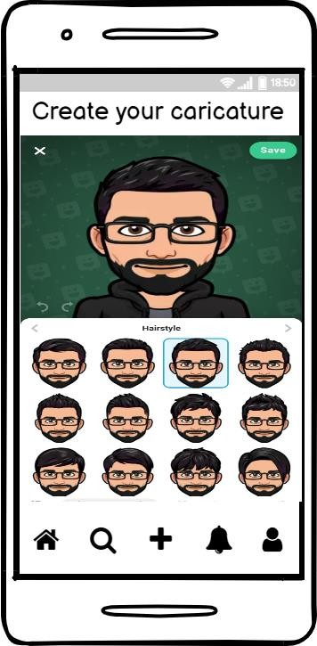
Feature – Videos will be recorded and before posting it user will be allowed to replace himself or any of the person in video with its caricatures. List of caricatures will be shown by the platform, and also user can design his own caricatures by selecting various attributes like skin color, hairstyle etc.
Metrics to Consider -
Month on month new users creating content.
DAU/MAU
Caricatures number going live.
Insights – This feature will help all the camera conscious users or the creators who have a lot of content to publish but have been hesitating till now because of shyness.
User value proposition – Users will be prompted a list of caricatures upon using this feature and also their will be an option to design it from starch. Where user can select all the facial features, hairstyles, clothes etc. on his own. In settings their will be an option ‘Use caricatures’, if this will be selected every time upon posting a video it will show the list of caricatures, without choosing one it will not allow user to post the video.

Slide 5

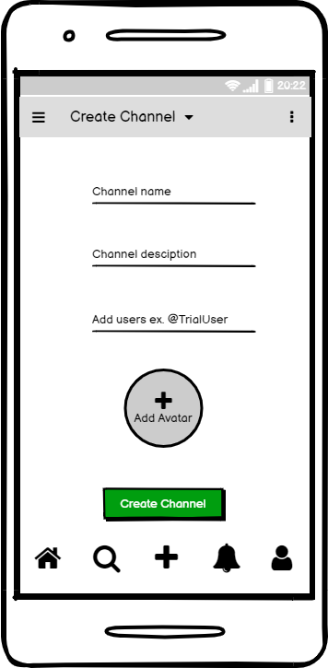
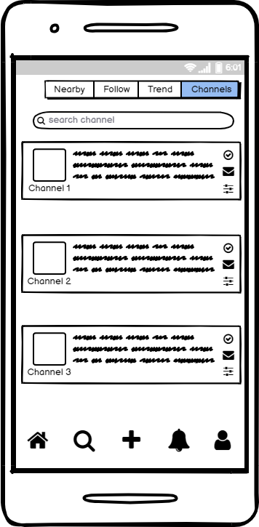
Feature – This will be knowledge kind of channel where creators adding short video will be shown only if we subscribe the channel. It wont be mixed up with the other cringy content.
Insights – More number of users will create videos who were previously uncomfortable about mixing there knowledge content with other cringe content.
User value proposition – Adding short videos related to any knowledge topic like stocks, health, cooking, etc. will give freedom to more number of users to create good videos and upload without getting mixed to the other short clips which are just for entertainment.
Metrices to consider –
Channels created
Users spending time on channels tab

Slide 6

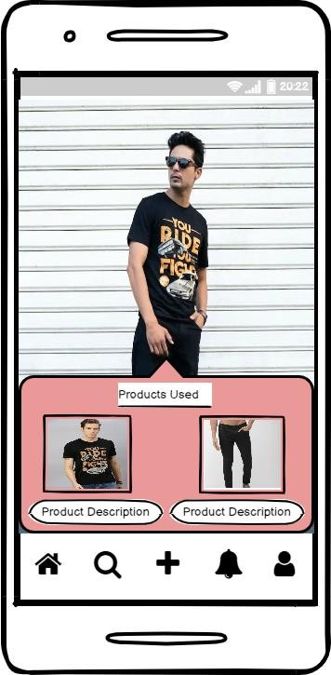
Feature – Recorded videos will be given a feature to display the products used in it before posting it. Upon clicking ‘product used’ complete description of the product can be read by the viewers and also a link will be present from where it will be redirected to the site where it can be purchased.
Metrics to Consider -
Month on month new users creating content.
DAU/MAU
Clicks on ‘product used’ feature to see how users are using the feature.
Insights – This feature will help the creators to give the complete details of the product used in that particular video. Which in return will help viewers to search that product online easily.
User value proposition – This feature can be a crucial feature for creators, viewers and also for ‘MX TakaTak’, as everyone will be benefited from this feature.
Creators will be able to add and display their products, viewers who liked will get to know where to purchase, for ‘MX TakaTak’ it can be a selling platform.

Slide 7
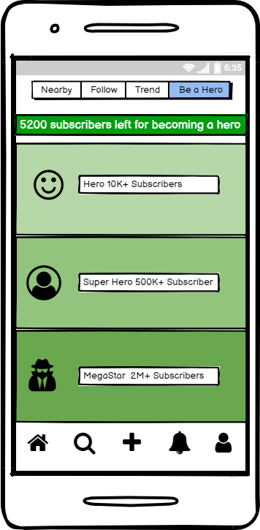
Feature – This retention feature will be a kind of levels which any creator can achieve by increasing the number of subscriber and adding more content to the platform.
Insights – Each level will unlock various benefits to the creator like whenever MX TakaTak will be having some events it will call its Superhero's and Megastars to the event.
User Value proposition – This will be the measuring point of success for any creator and to achieve next level they will be adding more content to the platform in return ‘MX TakaTak’ will reward their creators accordingly which will boost the creators to add more content and cross next levels.
Metrics to Consider -
Activeness of creators on the platform.
Videos added to the platform daily / monthly.

Slide 8





